Slide 1
Acetyl-CoA
ACC
HCO₃⁻, ATP
ADP + P_{i}
Malonyl-CoA
FabD
ACP
CoA
Malonyl-ACP
FabH
Acetyl-CoA
CoA, CO₂
ACP, CO₂
β-ketoacyl-ACP
NADPH + H⁺
Malonyl-ACP
FabB
FabG
NADP⁺
FabF
TesA
Free Fatty Acid
ACP
H₂O
Acyl-ACP
β-hydroxy-acyl-ACP
FabI
FabA
NAD⁺
FabZ
H₂O
NADH + H⁺
Enoyl-acyl-ACP
Notes:
E. coli

Slide 2
Acetyl-CoA
ACC
HCO₃⁻, ATP
ADP + P_{i}
Malonyl-CoA
FabD
ACP
CoA
Malonyl-ACP
FabH
Acetyl-CoA
CoA, CO₂
ACP, CO₂
β-ketoacyl-ACP
NADPH + H⁺
Malonyl-ACP
FabB
FabG
NADP⁺
FabF
TesA
Free Fatty Acid
ACP
H₂O
Acyl-ACP
β-hydroxy-acyl-ACP
FabI
FabA
NAD⁺
FabZ
H₂O
NADH + H⁺
Enoyl-acyl-ACP
Notes:
E. coli

Slide 3
Acetyl-CoA
ACC
HCO₃⁻, ATP
ADP + P_{i}
Malonyl-CoA
FabD
ACP
CoA
Malonyl-ACP
FabH
Acetyl-CoA
CoA, CO₂
ACP, CO₂
β-ketoacyl-ACP
NADPH + H⁺
Malonyl-ACP
FabB
FabG
NADP⁺
FabF
TesA
Free Fatty Acid
ACP
H₂O
Acyl-ACP
β-hydroxy-acyl-ACP
FabI
FabA
NAD⁺
FabZ
H₂O
NADH + H⁺
Enoyl-acyl-ACP
Notes:
E. coli

Slide 4
Acetyl-CoA
ACC
HCO₃⁻, ATP
ADP + P_{i}
Malonyl-CoA
FabD
ACP
CoA
Malonyl-ACP
FabH
Acetyl-CoA
CoA, CO₂
ACP, CO₂
β-ketoacyl-ACP
NADPH + H⁺
Malonyl-ACP
FabB
FabG
NADP⁺
FabF
TesA
Free Fatty Acid
ACP
H₂O
Acyl-ACP
β-hydroxy-acyl-ACP
FabI
FabA
NAD⁺
FabZ
H₂O
NADH + H⁺
Enoyl-acyl-ACP
Notes:
E. coli

Slide 5
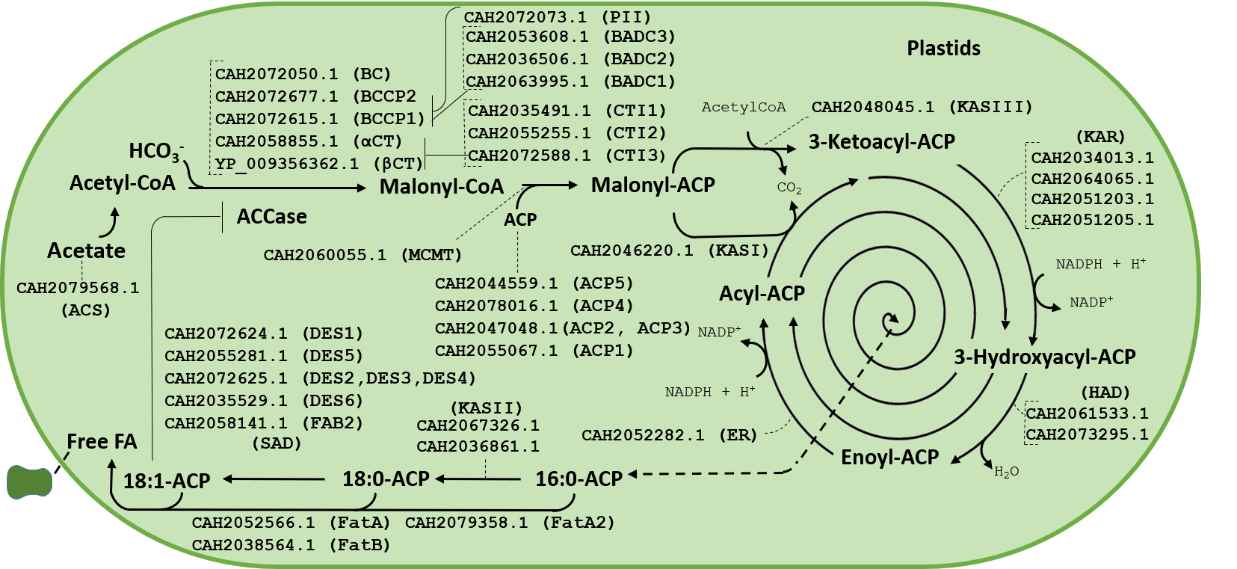
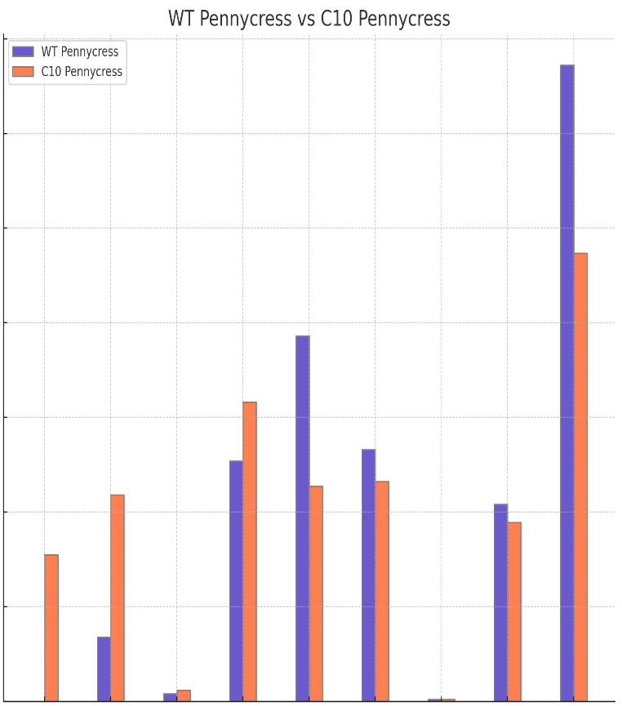
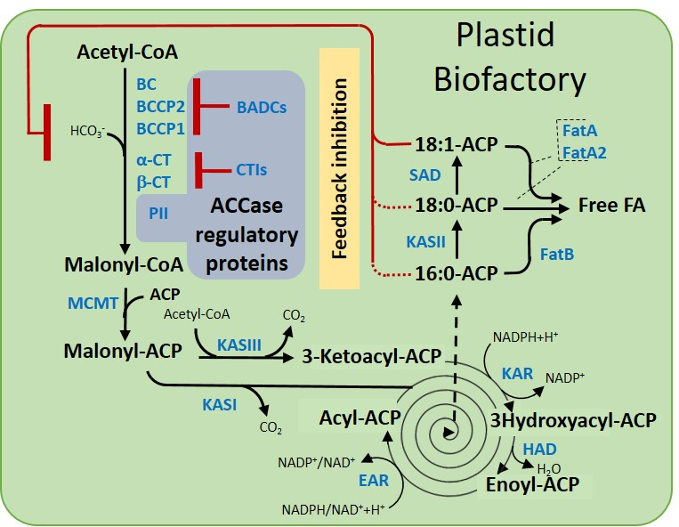
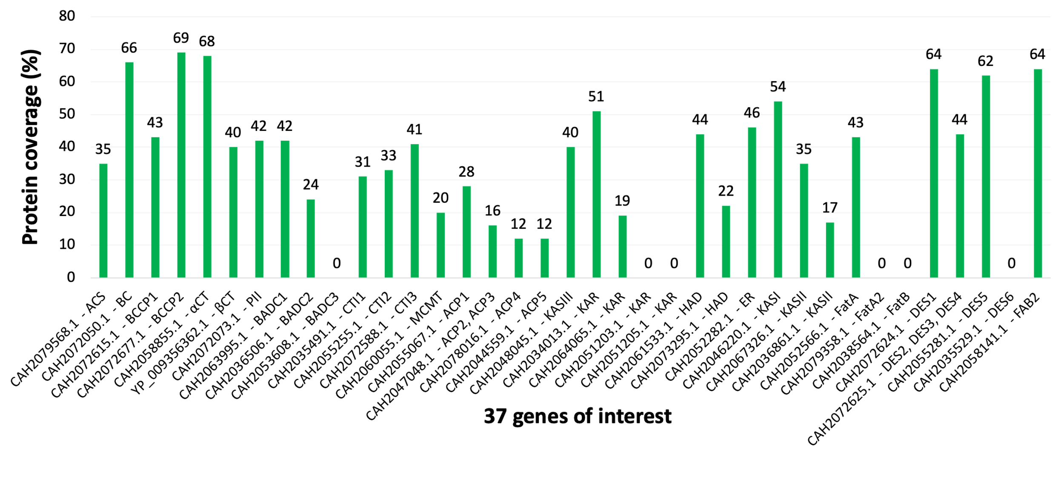
Pennycress
35
WT Pennycress
C10 Pennycress
30
25
Content (%)
20
15
10
5
0
10:0
16:0
18:0
18:1
18:2
18:3
20:0
20:1
22:1
Notes:
Aim 1 Poster

Slide 6
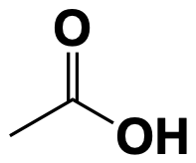
ACS
Acetate
CoA, ATP
AMP + PP_{i}
Acetyl-CoA
ACC
HCO₃⁻, ATP
ADP + P_{i}
Malonyl-CoA
MCMT
ACP
CoA
H₂O
18:1-ACP
Malonyl-ACP
ACP
SAD
FatA
KAS III
Acetyl-CoA
CoA, CO₂
FatA2 FatA
Free Fatty Acid
ACP
H₂O
18:0-ACP
β-ketoacyl-ACP
FatB FatA
ACP, CO₂
NADPH + H⁺
KAS II
Malonyl-ACP
KAS I
KAR
NADP⁺
ACP
H₂O
16:0-ACP
Acyl-ACP
β-hydroxy-acyl-ACP
NAD⁺
ER
HAD
NADH + H⁺
H₂O
Enoyl-acyl-ACP
Notes:
Pennycress from poster
Not sure what reaction KAS II and SAD are doing mechanism wise - hard to find
Poster shows no FatB and FatA2

Slide 7
18:3
Acetyl-CoA
Fad3
ACC
HCO₃⁻, ATP
ADP + P_{i}
18:2
Malonyl-CoA
Fad2
MCMT
ACP
CoA
Fae1
Fae1
FatB
22:1
20:1
18:1
ACP
H₂O
18:1-ACP
Malonyl-ACP
SAD
KAS III
Acetyl-CoA
CoA, CO₂
Fae1
Fae1
FatA
22:0
20:0
18:0
ACP
H₂O
18:0-ACP
β-ketoacyl-ACP
ACP, CO₂
NADPH + H⁺
KAS II
Malonyl-ACP
KAS I
KAR
NADP⁺
FatB
16:0
ACP
H₂O
16:0-ACP
Acyl-ACP
β-hydroxy-acyl-ACP
PAD
NAD⁺
ER
HAD
NADH + H⁺
H₂O
FatB
Enoyl-acyl-ACP
16:1
ACP
H₂O
16:1-ACP
Notes:
Oilcrops from
https://doi.org/10.1007/s10722-022-01391-w

Slide 8
Highlighted means not in poster genes – also in ER not plastid so maybe that is why, or they are just named differently
Boxed are FA products
KAS II, SAD, Fae, and Fad not sure mechanism yet
18:3
Acetyl-CoA
Fad3
ACC
HCO₃⁻, ATP
ADP + P_{i}
18:2
Malonyl-CoA
Fad2
MCMT
ACP
CoA
Fae1
Fae1
FatA
22:1
20:1
18:1
ACP
H₂O
18:1-ACP
Malonyl-ACP
SAD
KAS III
Acetyl-CoA
CoA, CO₂
FatA
18:0
ACP
H₂O
18:0-ACP
β-ketoacyl-ACP
ACP, CO₂
NADPH + H⁺
KAS II
Malonyl-ACP
KAS I
KAR
NADP⁺
FatA
16:0
ACP
H₂O
16:0-ACP
Acyl-ACP
β-hydroxy-acyl-ACP
NAD⁺
ER
HAD
NADH + H⁺
H₂O
Enoyl-acyl-ACP
Notes:
Oilcrops from
https://doi.org/10.1007/s10722-022-01391-w
Simplified based on poster and source below
Des = desaturase
Fad = fatty acid desaturase
Fae = fatty acid elongase
Fad2/3 and Fae1 are not in poster but they’re also in the ER not the plastid
https://doi.org/10.3389/fpls.2023.1076704

Slide 9
Highlighted means not in poster genes – also in ER not plastid so maybe that is why, or they are just named differently
Boxed are FA products
KAS II, SAD, Fae, and Fad not sure mechanism yet
18:3
Acetyl-CoA
Fad3
ACC
HCO₃⁻, ATP
ADP + P_{i}
18:2
Malonyl-CoA
Fad2
MCMT
ACP
CoA
Fae1
Fae1
FatA
22:1
20:1
18:1
ACP
H₂O
18:1-ACP
Malonyl-ACP
SAD
KAS III
Acetyl-CoA
CoA, CO₂
FatA
18:0
ACP
H₂O
18:0-ACP
β-ketoacyl-ACP
ACP, CO₂
KAS I
NADPH + H⁺
Malonyl-ACP
KAR
NADP⁺
KAS II
FatA
16:0
ACP
H₂O
16:0-ACP
Acyl-ACP
β-hydroxy-acyl-ACP
NAD⁺
ER
HAD
NADH + H⁺
H₂O
Enoyl-acyl-ACP
Notes:
Oilcrops from
https://doi.org/10.1007/s10722-022-01391-w
Simplified based on poster and source below
Des = desaturase
Fad = fatty acid desaturase
Fae = fatty acid elongase
Fad2/3 and Fae1 are not in poster but they’re also in the ER not the plastid
https://doi.org/10.3389/fpls.2023.1076704

Slide 10
Acetyl-CoA
ACC
HCO₃⁻, ATP
ADP + P_{i}
18:3
Malonyl-CoA
Fad3
MCMT
ACP
CoA
18:2
Malonyl-ACP
Fad2
KAS III
Acetyl-CoA
CoA, CO₂
Fae1
Fae1
FatA
22:1
20:1
18:1
ACP
H₂O
18:1-ACP
β-ketoacyl-ACP
ACP, CO₂
KAS I
NADPH + H⁺
SAD
H₂O, Fd²⁺
Malonyl-ACP
KAR
NADP⁺
O₂, Fd⁺ + H⁺
KAS II
Fae1
Fae1
FatA
22:0
20:0
18:0
ACP
H₂O
18:0-ACP
Acyl-ACP
β-hydroxy-acyl-ACP
NAD⁺
ER
HAD
NADH + H⁺
H₂O
FatA
Enoyl-acyl-ACP
16:0
ACP
H₂O
16:0-ACP
Notes:
https://doi.org/10.1007/s10722-022-01391-w
https://doi.org/10.3389/fpls.2023.1076704

Slide 11
Acetyl-CoA
ACC
HCO₃⁻, ATP
ADP + P_{i}
18:3
Malonyl-CoA
Fad3
MCMT
ACP
CoA
18:2
Malonyl-ACP
Fad2
KAS III
Acetyl-CoA
CoA, CO₂
Fae1
Fae1
FatA
22:1
20:1
18:1
ACP
H₂O
18:1-ACP
β-ketoacyl-ACP
ACP, CO₂
KAS I
NADPH + H⁺
SAD
H₂O, Fd²⁺
Malonyl-ACP
KAR
NADP⁺
O₂, Fd⁺ + H⁺
KAS II
Fae1
Fae1
FatA
22:0
20:0
18:0
ACP
H₂O
18:0-ACP
Acyl-ACP
β-hydroxy-acyl-ACP
NAD⁺
ER
HAD
NADH + H⁺
H₂O
FatA
Enoyl-acyl-ACP
16:0
ACP
H₂O
16:0-ACP
Notes:
https://doi.org/10.1007/s10722-022-01391-w
https://doi.org/10.3389/fpls.2023.1076704

